Slide 1
Sales Presentation

Slide 2
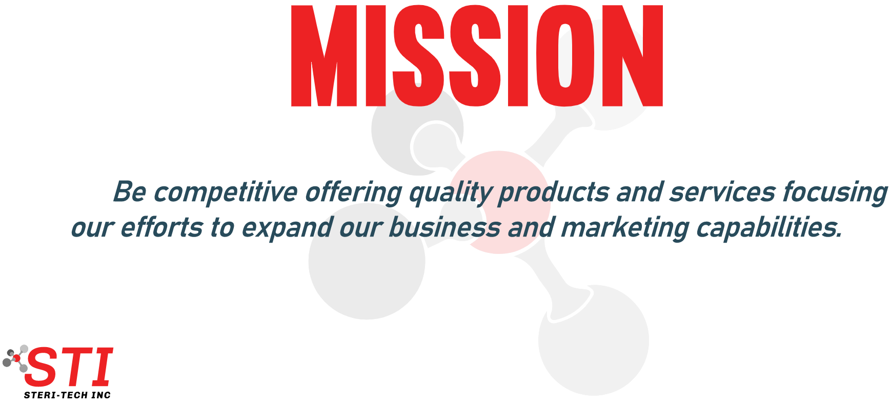
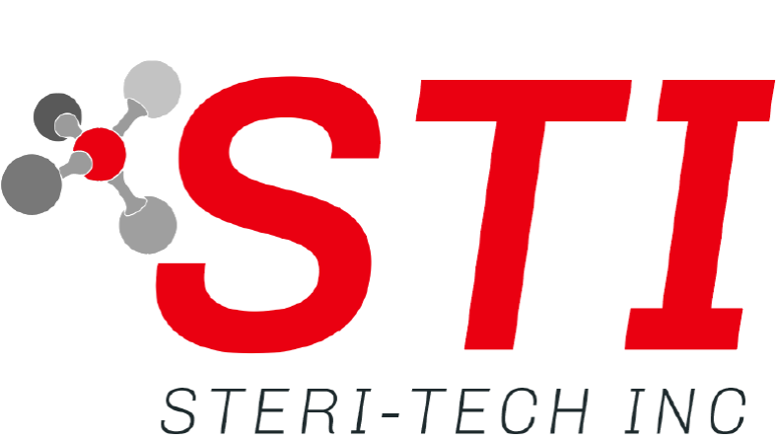
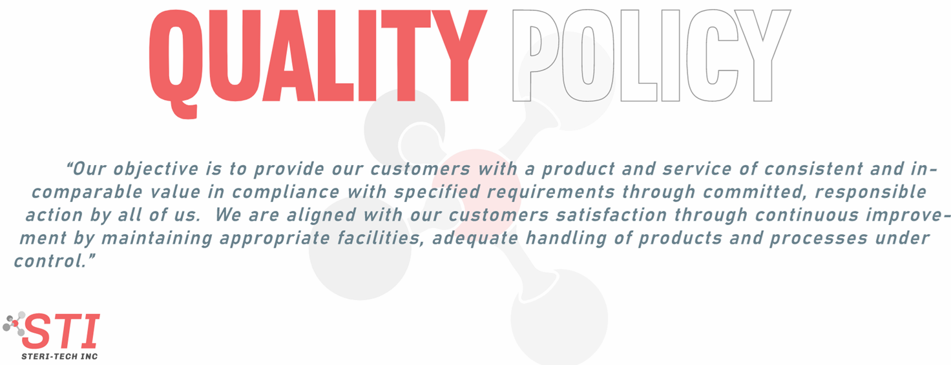
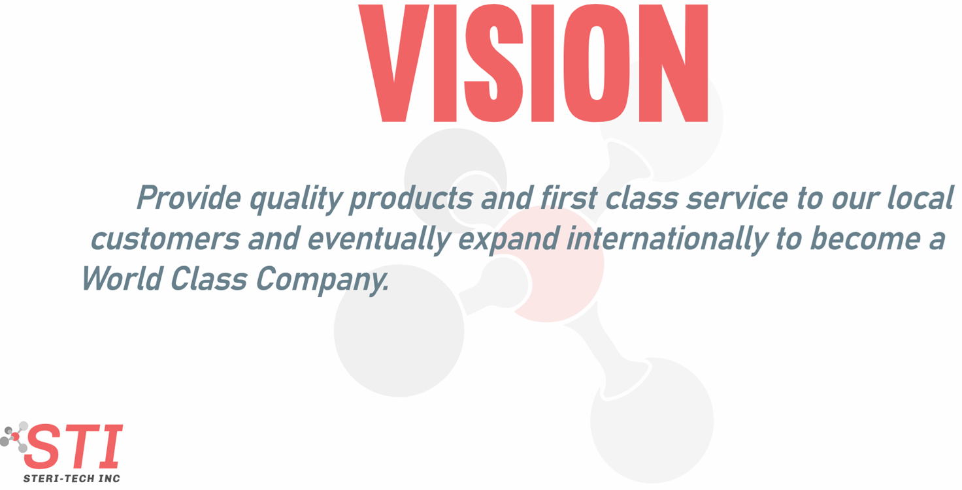

Slide 3
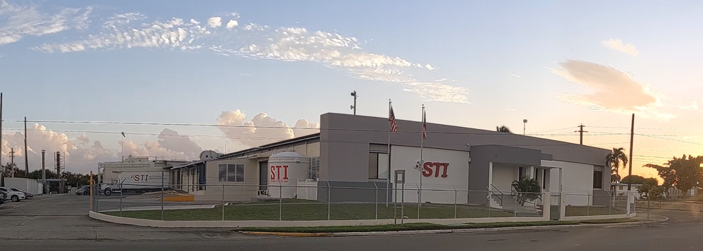
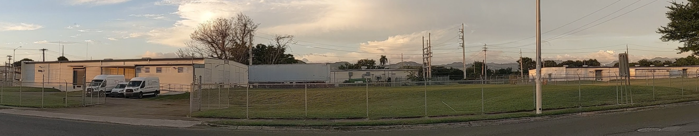
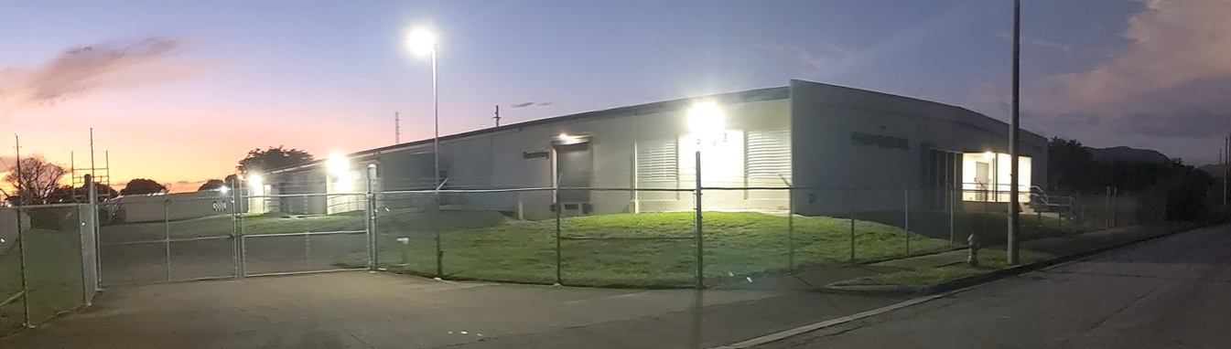
ABOUT US
Puerto Rican corporation founded in 1986. Present day has 43 employees
Minority and Hubzone certificates
24/7 – 365 Operations
Distribution Division: STI distributes disposable garments (PPE) and cleanroom cleaning supplies
Specialized in contract sterilization of medical devices with Ethylene Oxide (EO) and sterilization validation services.

Slide 4
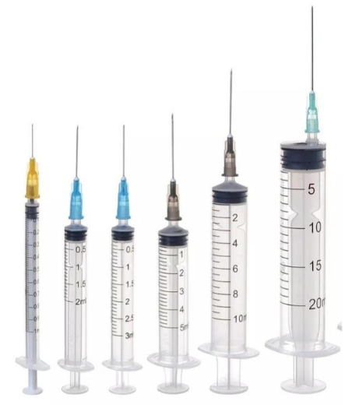
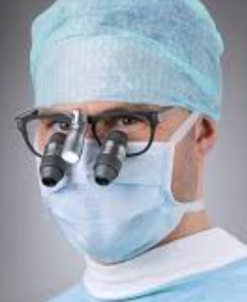

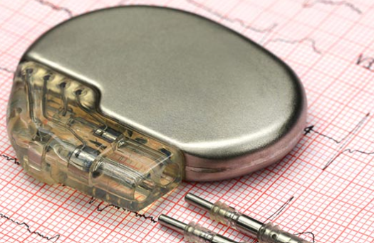
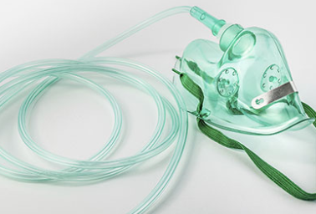
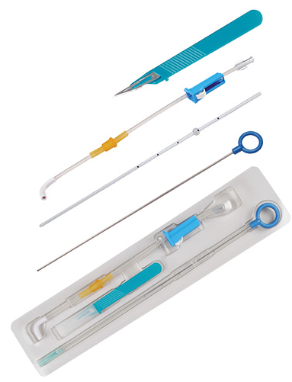
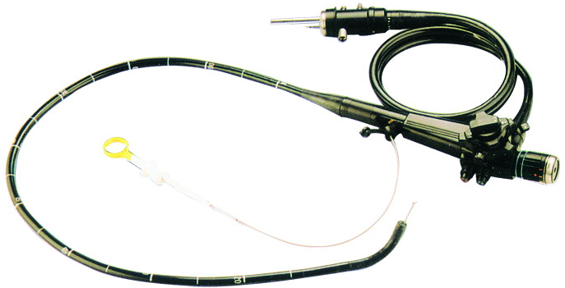
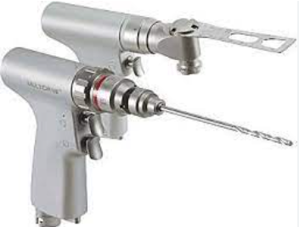
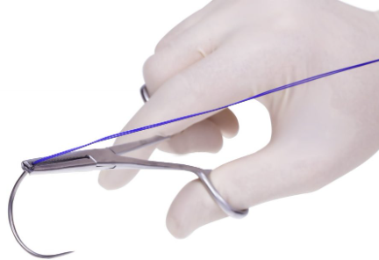
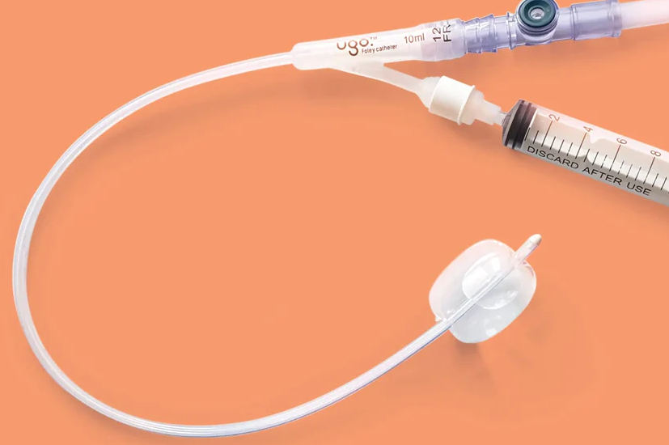
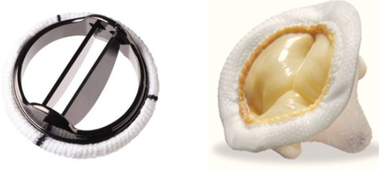
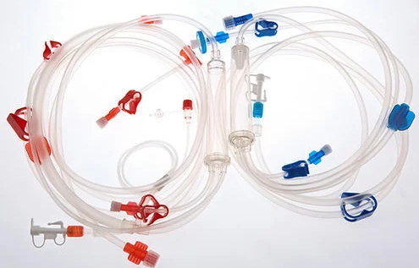
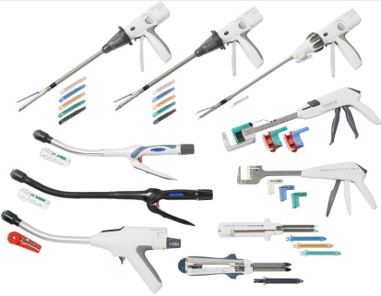
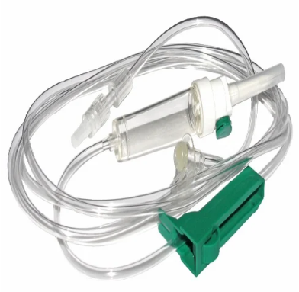
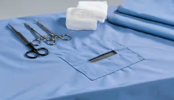
Importance of EO Sterilization
Examples of Medical Devices that require EO sterilization
For many medical devices, due to their size, shape, complexity or material composition, ethylene oxide (EO) is the only option for sterilization. For these products, alternatives such as steam, radiation or other sterilant do not achieve the needed levels of sterility assurance. In addition, for some medical devices, using non-EtO sterilization methods will result in material degradation, rendering the products potentially unsafe for patients.
More than 20 billion devices sold in the U.S. every year are sterilized with ethylene oxide, accounting for approximately 50% of devices that require sterilization.

Slide 5
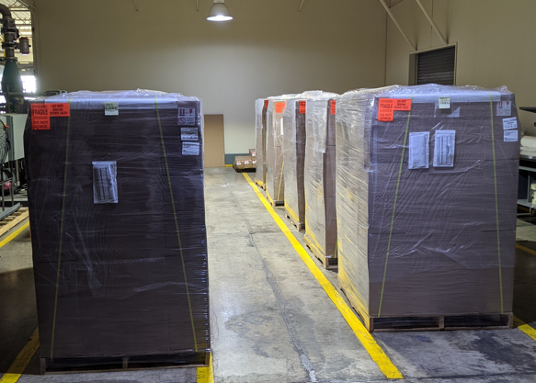

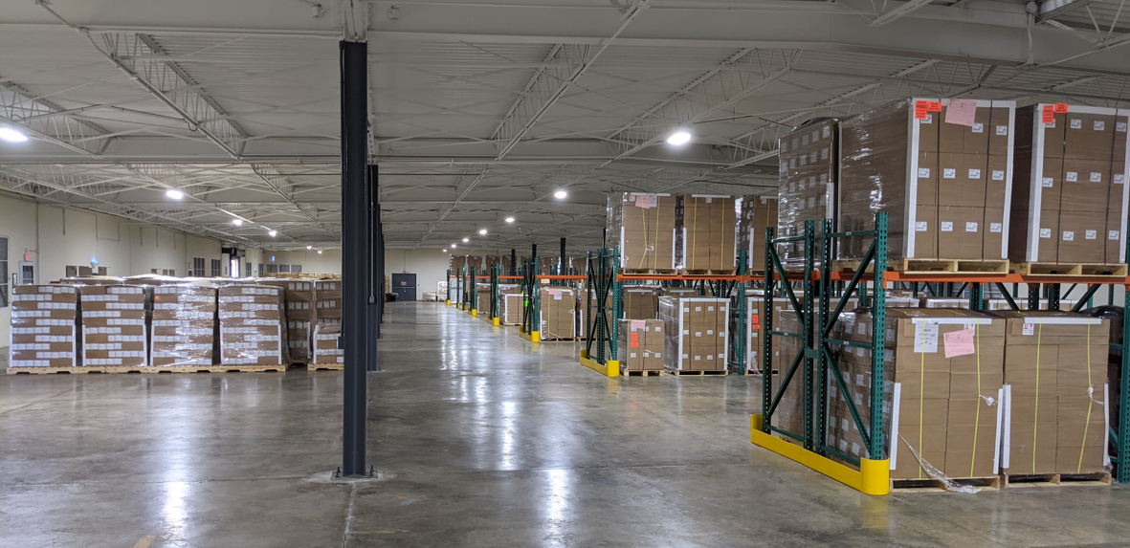
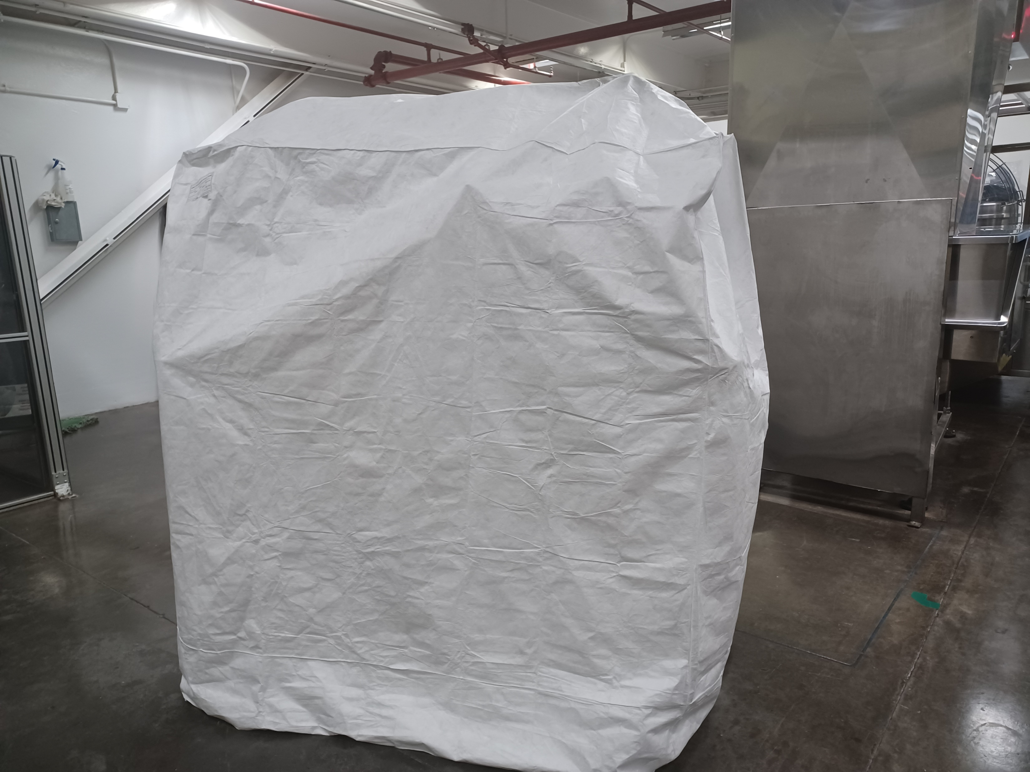
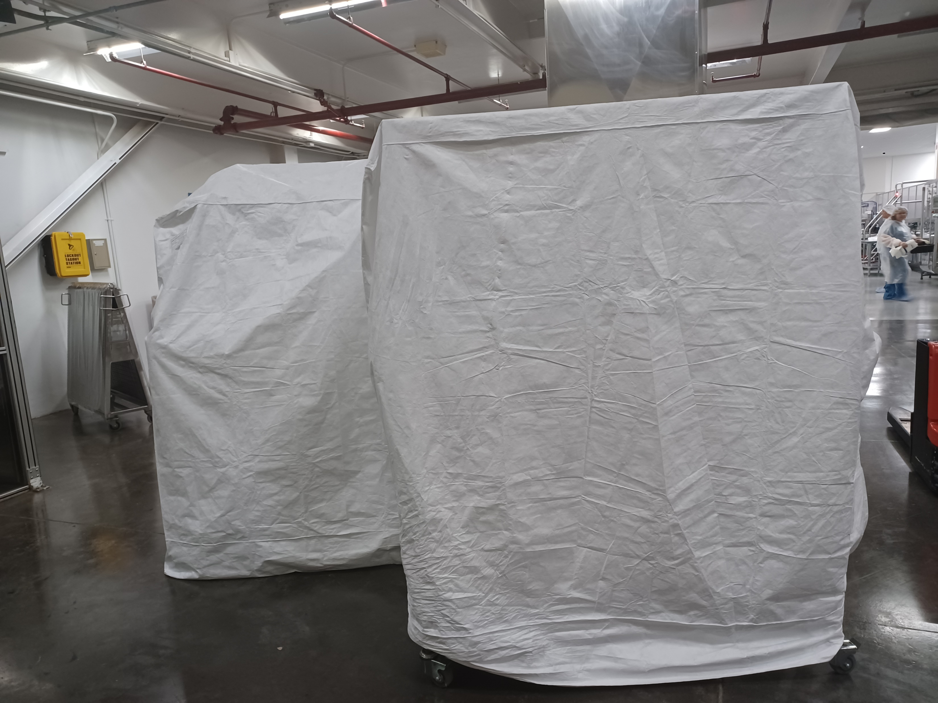
Other Business Units
Repalletization Division:
Perform Direct Shipment and Pick Packing Services
Warehousing Services
Custom Made Covers

Slide 6



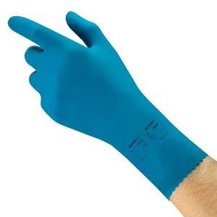
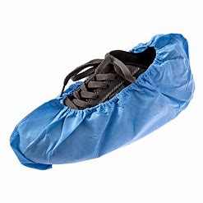
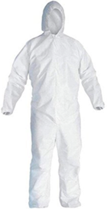
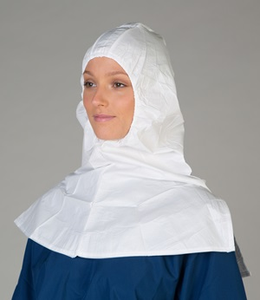


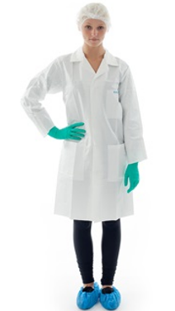
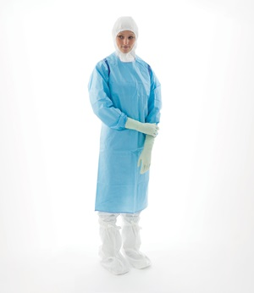
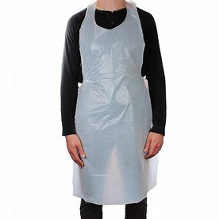
Distribution Division: STI distributes disposable garments (PPE)
Products not necessarily the same as those illustrated

Slide 7
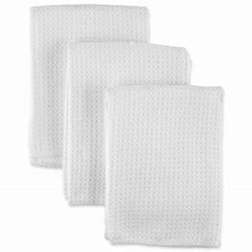
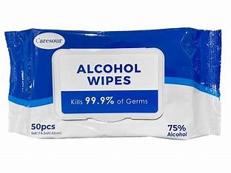
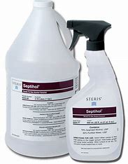
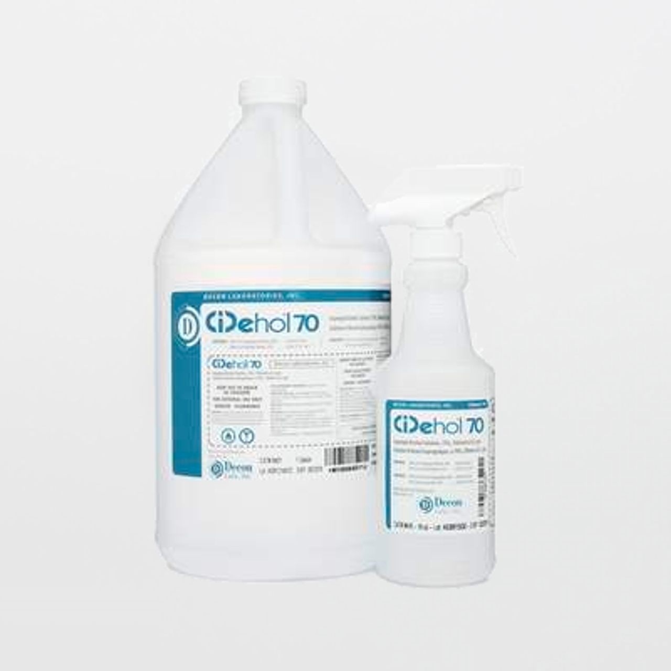
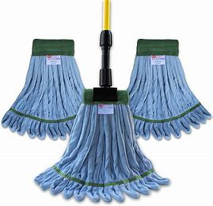

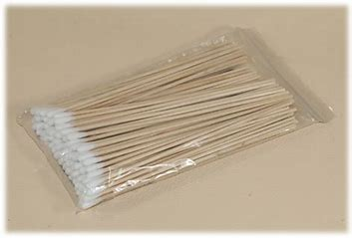
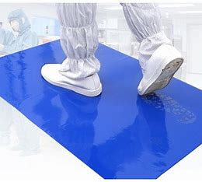
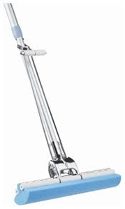
Dry Cloths
Alcohol Wipes
Sterile Alcohol
Distribution Division:
STI cleanroom cleaning supplies
Non-Sterile Alcohol
Mop
Swabs
Tacky Mats
Mop Refills
Products not necessarily the same as those illustrated

Slide 8









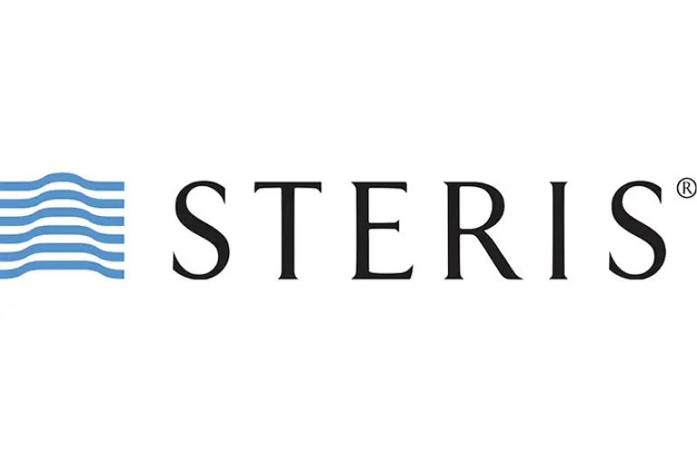

Some of our Disposables Suppliers

Slide 9









Some of our Disposables Customers

Slide 10
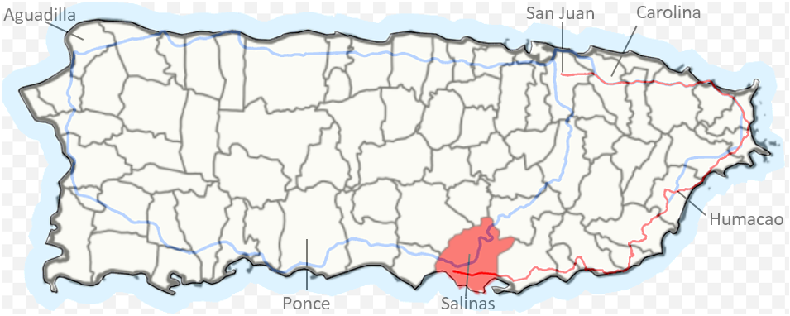
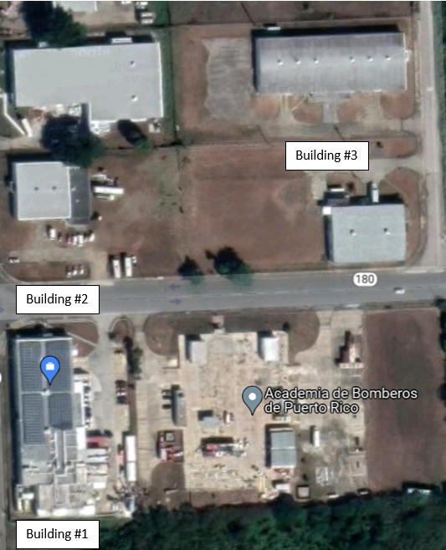
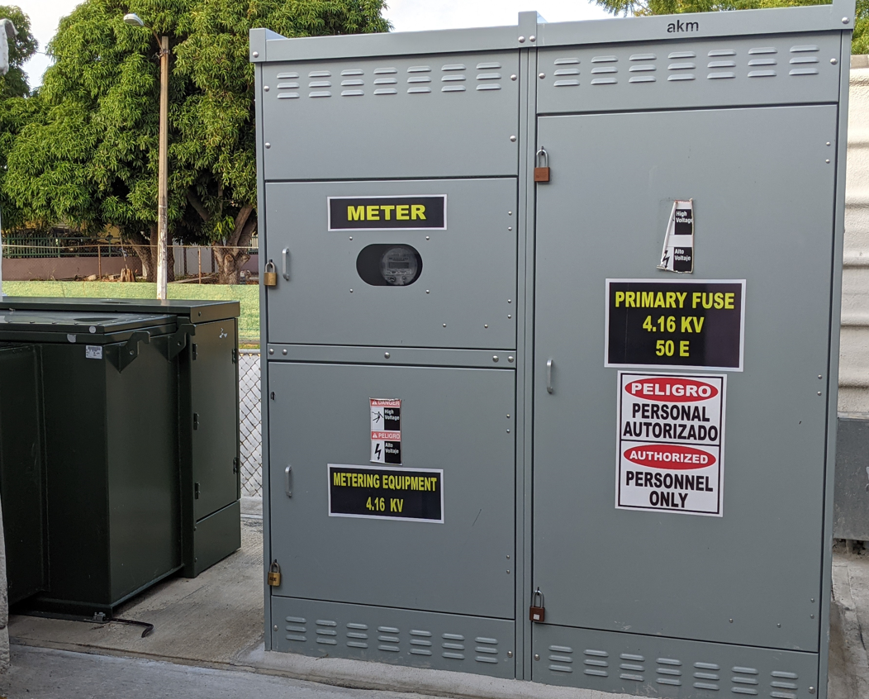
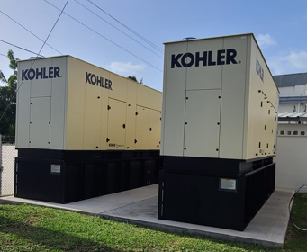
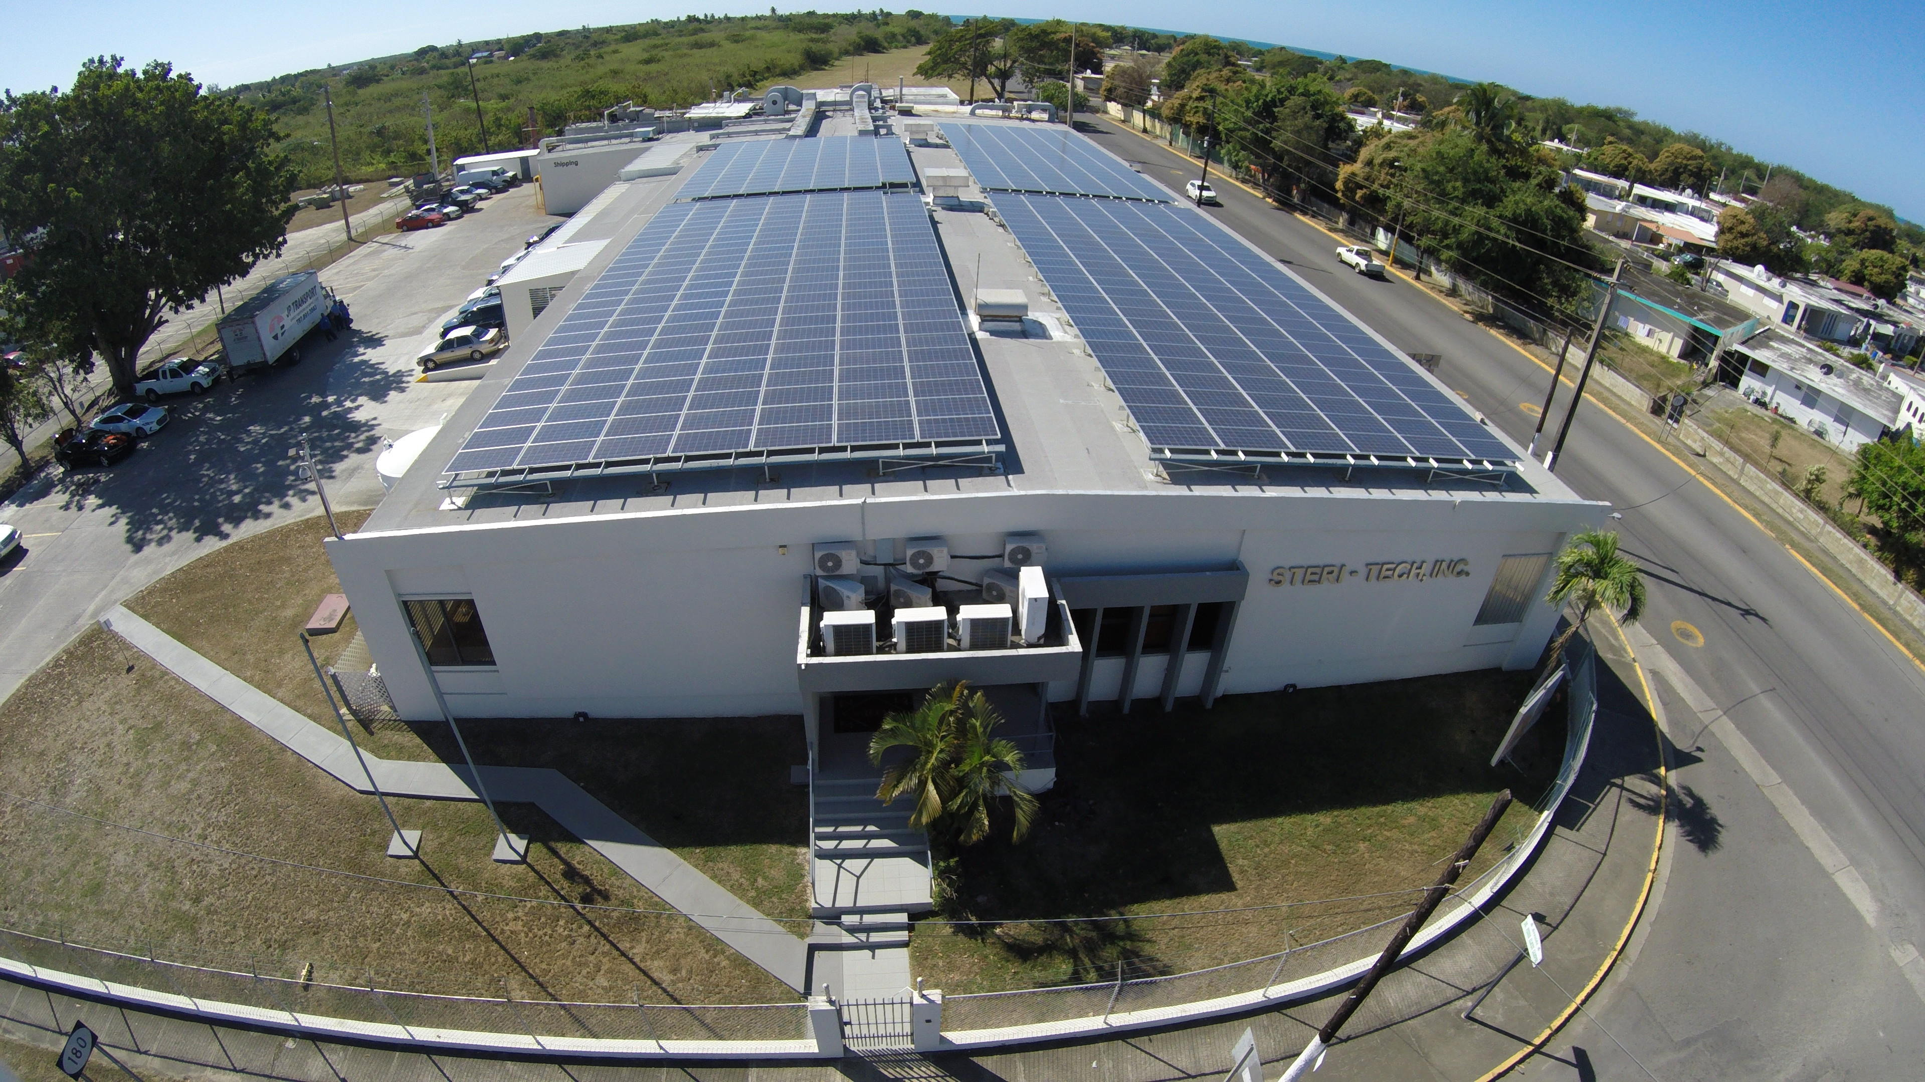
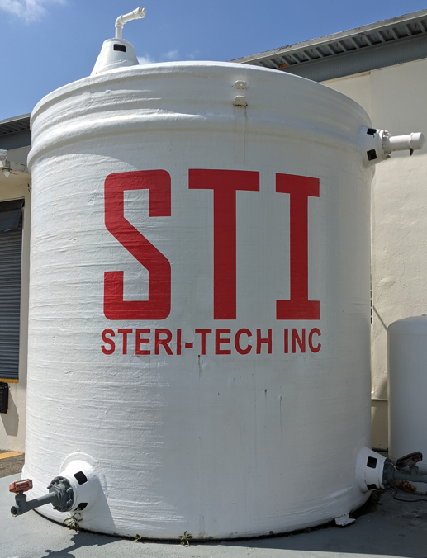
Strategic Location and Utilities Redundancy
75,000 ft² strategically located in Salinas, Puerto Rico
Solar Power Generation of 120kW with a consistent 25% power supply of current needs
Two 500kW diesel power generators
10,000 gallons of potable water cistern
All of this providing 100% utilities redundancy
500Kva Substation

Slide 11


REGULATORY STATUS
FDA Registered – Good Standing
  Last Audit : 02/2021
ISO
  ISO 11135: 2014 – Until: 11-06-2026
  ISO 13485 : 2016 – Until: 11-06-2026
  Last Audit: November 08 – 10 2022

Slide 12




Our Values
We are fully committed to the health care patients that will use medical devices sterilized by this company. We are committed in complying to the laws and regulations applicable to our business. We are fully committed to our partners, employees, the surrounding community, and all our stakeholders.
As a critical service provider to the medical device industry, integrity is our most valuable asset. We strive on being honest, respectful, responsible and on keeping our word. We are insistent in providing moral standards to our services and in day-to-day job functions.
Our cross-functional team structure provides opportunities to deliver more success through shared goals and mutual support. We always foment collaboration initiatives with our partners to align our service standards with their expectations. We also collaborate with different community initiatives and with public agencies when applicable.
In STI, we aspire to be the best. We foster professional growth and provide tools to move forward as leaders within our organization by establishing a culture of exceptional execution and rewarding those who create great outcomes. We focus on solutions, and making an impact through our talents, passion, and hard work. We know that in order to give health care patients the products they deserve we need to apply excellence in all the steps we perform as the final link in the manufacturing chain of our partners.

Slide 13



True North Elements
First Time Quality
Provide consistent service excellence:
Provide the appropriate training and resources that enable first time quality services
Simplify and standardize workflows and critical processes to improve execution
Keep production equipment running in optimal conditions
Stakeholder Wellbeing
Improve the wellbeing of our partners, employees, community members:
Provide growth opportunities to our employees and help them in living a healthy life
Maintain appropriate facilities and resources in order to guarantee a best-in-class service
Being a good corporate neighbor and making ourselves available to the community’s needs
Waste Reduction and Continuous Improvement
Establish a process excellence foundation by:
  Identifying waste in our processes and focusing on removing it using lean initiatives
  Identifying continuous improvement opportunities to maintain appropriate facilities and to apply best business practices
  Offering an environment of continuous development where you can do, and become, your best

Slide 14
THANKS

